Slide 1

Regular Expressions
Chapter 6

Slide 2
Regular Languages
Generates
Regular Language
Regular Expression
Recognizes
or
Accepts
Finite State Machine

Slide 3
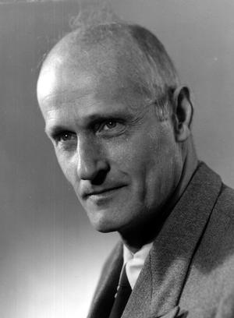
Stephen Cole Kleene
1909 – 1994, mathematical logician
One of many distinguished students (e.g., Alan Turing) of Alonzo Church (lambda calculus) at Princeton.
Best known as a founder of the branch of mathematical logic known as recursion theory.
Also invented regular expressions.
Kleene pronounced his last name KLAY-nee. `kli:ni and `kli:n are common mispronunciations.
  His son, Ken Kleene, wrote: "As far as I am aware
  this pronunciation is incorrect in all known languages.
  I believe that this novel pronunciation was invented
  by my father. "
Kleeneness is next to Godelness
  Cleanliness is next to Godliness
A pic of pic by me

Slide 4
Regular Expressions
Regular expression Σ contains two kinds of symbols:
  special symbols, ∅, ε, *, +, ∪, (, ) …
  symbols that regular expressions will match against
The regular expressions over an alphabet Σ are all and only the strings that can be obtained as follows:
1. ∅ is a regular expression.
2. ε is a regular expression.
3. Every element of Σ is a regular expression.
4. If α , β are regular expressions, then so is αβ.
5. If α , β are regular expressions, then so is α∪β.
6. If α is a regular expression, then so is α*.
7. α is a regular expression, then so is α⁺.
8. If α is a regular expression, then so is (α).

Slide 5
Regular Expression Examples
If Σ = {a, b}, the following are regular expressions:
∅
ε
a
(a ∪ b)*
abba ∪ ε

Slide 6
Regular Expressions Define Languages
Regular expressions are useful because each RE has a meaning
If the meaning of an RE α is the language A, then we say that α defines or describes A.
Define L, a semantic interpretation function for regular expressions:
1. L(∅) = ∅. //the language that contains no strings
2. L(ε) = {ε}. //the language that contains just the empty string
3. L(c) = {c}, where c ∈ Σ.
4. L(αβ) = L(α) L(β).
5. L(α ∪ β) = L(α) ∪ L(β).
6. L(α*) = (L(α))*.
7. L(α⁺) = L(αα*) = L(α) (L(α))*. If L(α) is equal to ∅, then L(α⁺) is also equal to ∅. Otherwise L(α⁺) is the language that is formed by concatenating together one or more strings drawn from L(α).
8. L((α)) = L(α).

Slide 7
The Role of the Rules
Rules 1, 3, 4, 5, and 6 give the language its power to define sets.
Rule 8 has as its only role grouping other operators.
Rules 2 and 7 appear to add functionality to the regular expression language, but they don’t.
2. ε is a regular expression.
7. α is a regular expression, then so is α⁺.
Notes:
2. there’s alternative mechanism for describing L(ε). L(∅*) = {ε}
7. α+ = aa*. α+ is a convenient shortcut.

Slide 8
Analyzing a Regular Expression
The compositional semantic interpretation function lets us map between regular expressions and the languages they define.
L((a ∪ b)*b) = L((a ∪ b)*) L(b)
= (L((a ∪ b)))* L(b)
= (L(a) ∪ L(b))* L(b)
= ({a} ∪ {b})* {b}
= {a, b}* {b}.
Notes:
Set of all strings over the alphabet {a,b} that end in b

Slide 9
Examples
L( a*b* ) =
L( (a ∪ b)* ) =
L( (a ∪ b)*a*b* ) =
L( (a ∪ b)*abba(a ∪ b)* ) =
L( (a ∪ b) (a ∪ b)a(a ∪ b)* ) =
Notes:
Last: the language that contains all strings of a’s and b’s such that there exists a third character and it is an a.

Slide 10
Going the Other Way
Given a language, find a regular expression
L = {w ∈ {a, b}*: |w| is even}
((a ∪ b) (a ∪ b))*
(aa ∪ ab ∪ ba ∪ bb)*
L = {w ∈ {a, b}*: w contains an odd number of a’s}
b* (ab*ab*)* a b*
b* a b* (ab*ab*)*
Notes:
Is the semantic interpretation function we have defined for regular expressions one-to-one?

Slide 11
Common Idioms
(α ∪ ε)
  Optional α, matching α or the empty string
(a ∪ b)*
  Set of all strings composed of the characters a and b
The regular expression a* is simply a string. It is different from the language L(a*) ={w: w is composed of zero or more a’s}.
However, when no confusion, we do not write the semantic interpretation function explicitly. We will say things like, “The language a* is infinite”

Slide 12
Operator Precedence in Regular Expressions
Regular Arithmetic
Expressions Expressions
Highest Kleene star exponentiation
concatenation multiplication
Lowest union addition
a b* ∪ c d* x y² + i j²

Slide 13
The Details Matter
a* ∪ b* ≠ (a ∪ b)*
(ab)* ≠ a*b*

Slide 14
Kleene’s Theorem
Finite state machines and regular expressions define the same class of languages. To prove this, we must show:
Theorem: Any language that can be defined with a regular expression can be accepted by some FSM and so is regular.
Theorem: Every regular language (i.e., every language that can be accepted by some DFSM) can be defined with a regular expression.
Sometimes FSM is easy, sometimes RE is easy.

Slide 15
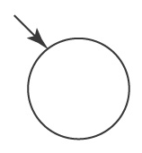
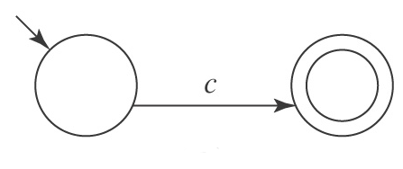
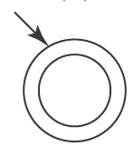
For Every Regular Expression α, There is a Corresponding FSM M s.t. L(α) = L(M)
We’ll show this by construction.
First, primitive regular expressions, then regular expressions that exploit the operations of union, concatenation, and Kleene star.
∅:
A single element of Σ:
ε (∅*):

Slide 16
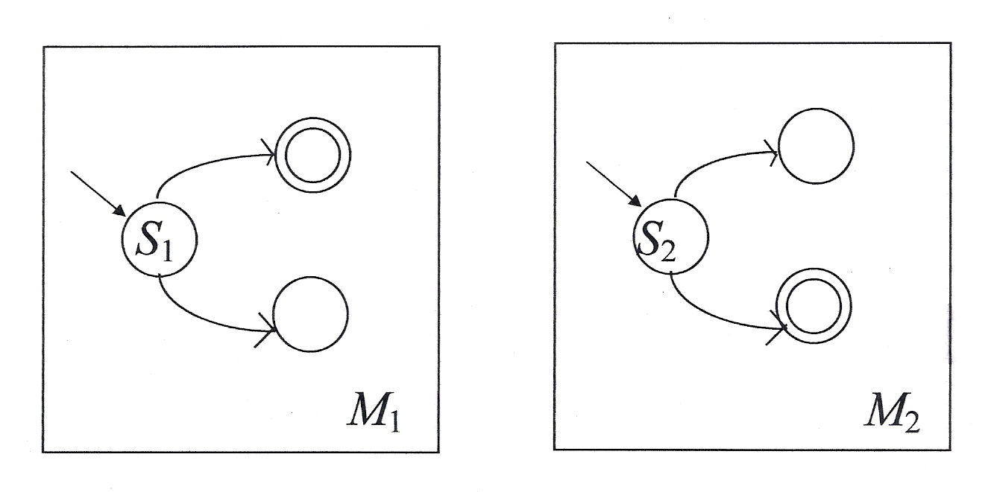
Union
If α is the regular expression β ∪ γ and if both L(β) and L(γ) are regular:
Notes:
Use NDFSM to combine the two

Slide 17
Concatenation
If α is the regular expression βγ and if both L(β) and L(γ) are regular:
Notes:
Use NDFSM to combine the two

Slide 18
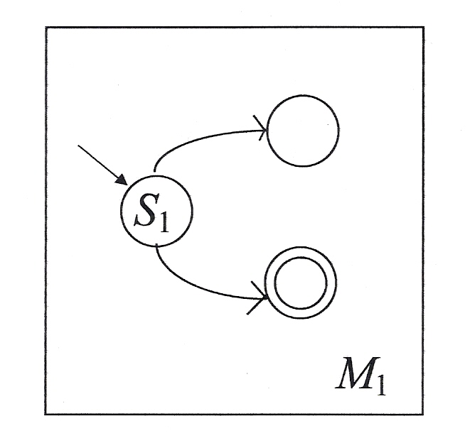
Kleene Star
If α is the regular expression β* and if L(β) is regular:

Slide 19
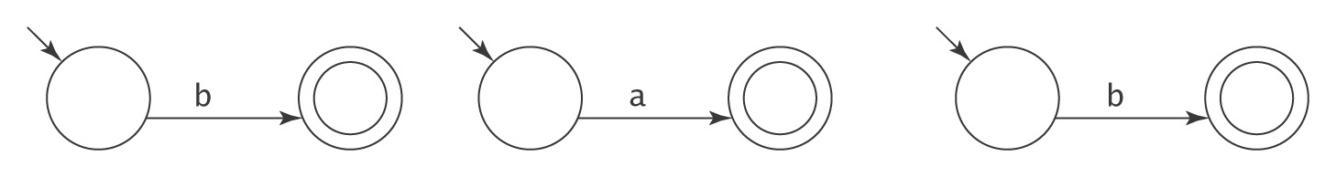
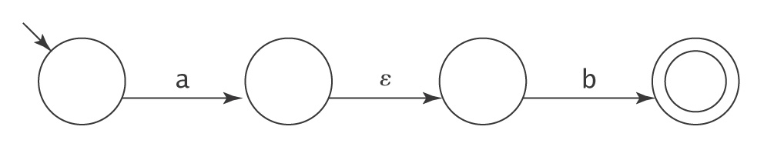
From RE to FSM: An Example
(b ∪ ab)*
An FSM for b An FSM for a An FSM for b
An FSM for ab:

Slide 20
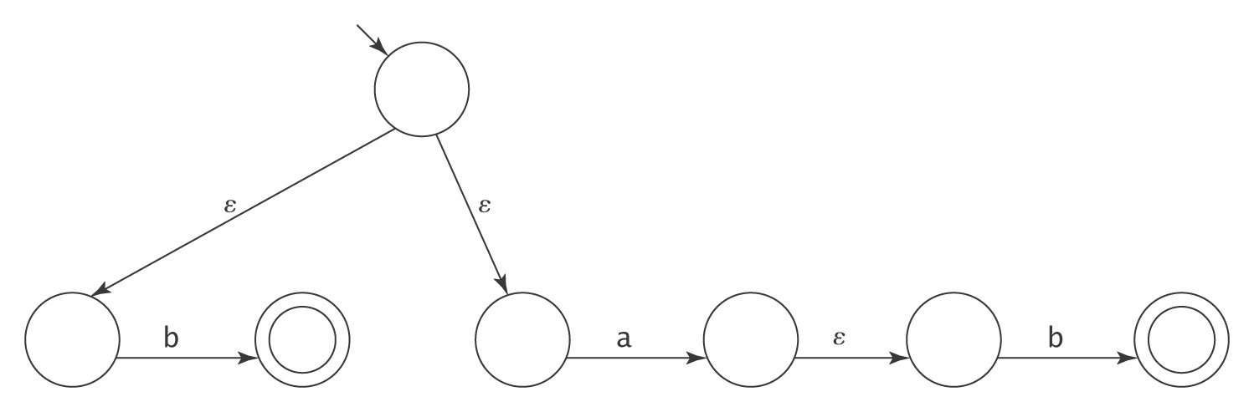
An Example
(b ∪ ab)*
An FSM for (b ∪ ab):

Slide 21
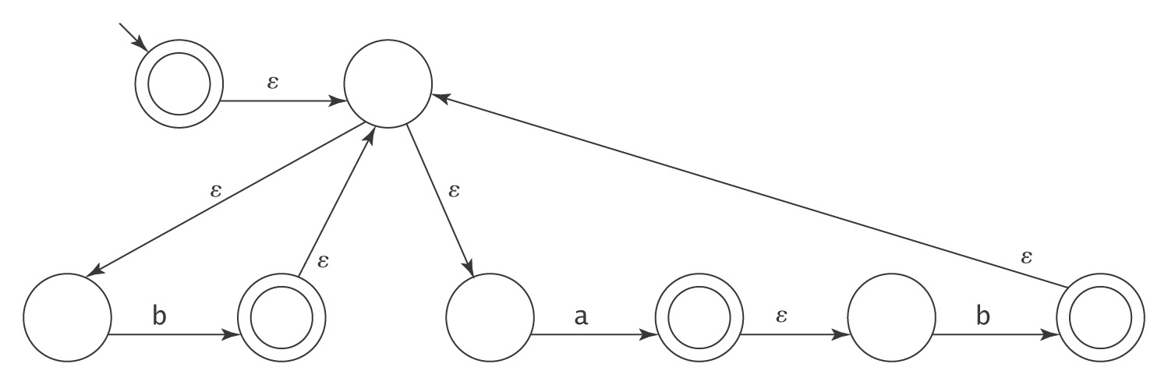
An Example
(b ∪ ab)*
An FSM for (b ∪ ab)*:
Error

Slide 22
The Algorithm regextofsm
regextofsm(α: regular expression) =
Beginning with the primitive subexpressions of α and
working outwards until an FSM for all of α has been
built do:
  Construct an FSM as described above.

Slide 23
For Every FSM There is a Corresponding Regular Expression
We’ll show this by construction.
The key idea is that we’ll allow arbitrary regular expressions to label the transitions of an FSM.
Read if interested …

Slide 24
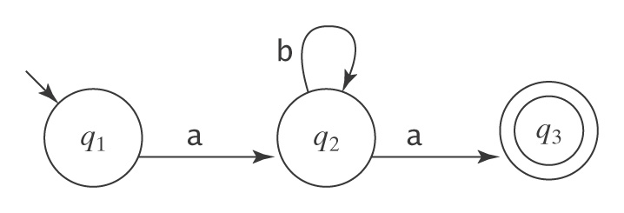
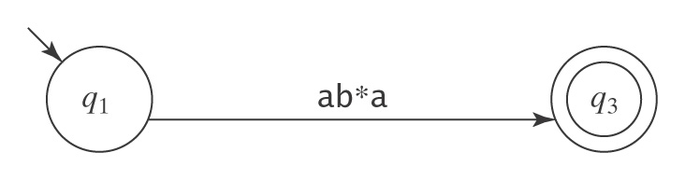
A Simple Example
Let M be:
Suppose we rip out state 2:

Slide 25
The Algorithm fsmtoregexheuristic
fsmtoregexheuristic(M: FSM) =
1. Remove unreachable states from M.
2. If M has no accepting states then return ∅.
3. If the start state of M is part of a loop, create a new start state s
and connect s to M’s start state via an ε-transition.
4. If there is more than one accepting state of M or there are any
transitions out of any of them, create a new accepting state and
connect each of M’s accepting states to it via an ε-transition. The
old accepting states no longer accept.
5. If M has only one state then return ε.
6. Until only the start state and the accepting state remain do:
  6.1 Select rip (not s or an accepting state).
  6.2 Remove rip from M.
  6.3 *Modify the transitions among the remaining states so M
  accepts the same strings.
7. Return the regular expression that labels the one remaining
transition from the start state to the accepting state.

Slide 26
Regular Expressions in Perl
Syntax | Name | Description
abc | Concatenation | Matches a, then b, then c, where a, b, and c are any regexs
a | b | c | Union (Or) | Matches a or b or c, where a, b, and c are any regexs
a* | Kleene star | Matches 0 or more a’s, where a is any regex
a+ | At least one | Matches 1 or more a’s, where a is any regex
a? |  | Matches 0 or 1 a’s, where a is any regex
a{n, m} | Replication | Matches at least n but no more than m a’s, where a is any regex
a*? | Parsimonious | Turns off greedy matching so the shortest match is selected
a+? | ″ | ″
. | Wild card | Matches any character except newline
^ | Left anchor | Anchors the match to the beginning of a line or string
$ | Right anchor | Anchors the match to the end of a line or string
[a-z] |  | Assuming a collating sequence, matches any single character in range
[^a-z] |  | Assuming a collating sequence, matches any single character not in range
\d | Digit | Matches any single digit, i.e., string in [0-9]
\D | Nondigit | Matches any single nondigit character, i.e., [^0-9]
\w | Alphanumeric | Matches any single “word” character, i.e., [a-zA-Z0-9]
\W | Nonalphanumeric | Matches any character in [^a-zA-Z0-9]
\s | White space | Matches any character in [space, tab, newline, etc.]

Slide 27
Regular Expressions in Perl
Syntax | Name | Description
\S | Nonwhite space | Matches any character not matched by \s
\n | Newline | Matches newline
\r | Return | Matches return
\t | Tab | Matches tab
\f | Formfeed | Matches formfeed
\b | Backspace | Matches backspace inside []
\b | Word boundary | Matches a word boundary outside []
\B | Nonword boundary | Matches a non-word boundary
\0 | Null | Matches a null character
\nnn | Octal | Matches an ASCII character with octal value nnn
\xnn | Hexadecimal | Matches an ASCII character with hexadecimal value nn
\cX | Control | Matches an ASCII control character
\char | Quote | Matches char; used to quote symbols such as . and \
(a) | Store | Matches a, where a is any regex, and stores the matched string in the next variable
\1 | Variable | Matches whatever the first parenthesized expression matched
\2 |  | Matches whatever the second parenthesized expression matched
… |  | For all remaining variables
  Testing. many other online tools

Slide 28
Using Regular Expressions
in the Real World
Matching numbers:
-? ([0-9]+(\.[0-9]*)? | \.[0-9]+)
Matching ip addresses:
[0-9]{1,3} (\ . [0-9] {1,3}){3}
Trawl for email addresses:
\b[A-Za-z0-9_%-]+@[A-Za-z0-9_%-]+ (\.[A-Za-z]+){1,4}\b
From Friedl, J., Mastering Regular Expressions, O’Reilly,1997.
IE: information extraction, unstructured data management

Slide 29
A Biology Example – BLAST
Given a protein or DNA sequence, find others that are likely to be evolutionarily close to it.
ESGHDTTTYYNKNRYPAGWNNHHDQMFFWV
Build a DFSM that can examine thousands of other sequences and find those that match any of the selected patterns.

Slide 30
Simplifying Regular Expressions
Regex’s describe sets:
● Union is commutative: α ∪ β = β ∪ α.
● Union is associative: (α ∪ β) ∪ γ = α ∪ (β ∪ γ).
● ∅ is the identity for union: α ∪ ∅ = ∅ ∪ α = α.
● Union is idempotent: α ∪ α = α.
Concatenation:
● Concatenation is associative: (αβ)γ = α(βγ).
● ε is the identity for concatenation: α ε = ε α = α.
● ∅ is a zero for concatenation: α ∅ = ∅ α = ∅.
Concatenation distributes over union:
● (α ∪ β) γ = (α γ) ∪ (β γ).
● γ (α ∪ β) = (γ α) ∪ (γ β).
Kleene star:
● ∅* = ε.
● ε* = ε.
●(α*)* = α*.
● α*α* = α*.
●(α ∪ β)* = (α*β*)*.

Slide 31
Regular Grammars
Chapter 7
Notes:
We have considered two equivalent ways to describe exactly the class of regular languages, FSM and RE.
Now, a third, regular grammers

Slide 32
Regular Languages
Generates
Regular Language
Regular Grammar
Recognizes
or
Accepts
Finite State Machine

Slide 33
Regular Grammars
A regular grammar G is a quadruple (V, Σ, R, S), where:
● V (rule alphabet) contains nonterminals and terminals
  terminals: symbols that can appear in strings generated by G
  nonterminals: symbols that are used in the grammar but do not appear in strings of the language
● Σ (the set of terminals) is a subset of V,
● R (the set of rules) is a finite set of rules of the form:
X → Y,
● S (the start symbol) is a nonterminal

Slide 34
Regular Grammars
In a regular grammar, all rules in R must:
● have a left hand side that is a single nonterminal
● have a right hand side that is:
● ε, or
● a single terminal, or
● a single terminal followed by a single nonterminal.
Legal: S → a, S → ε, and T → aS
Not legal: S → aSa and aSa → T
Regular grammars must always produce strings one character at a time, moving left to right.

Slide 35
Regular Grammars
The one we study is actually right regular grammar.
  Also called right linear grammar
  Generates context-free languages, recognized by FSM
  Note FSM reads the input string w left to right
Left regular grammar (left linear grammar)
  S → a, S → ε, and T → Sa
  Does it generate regular languages?

Slide 36
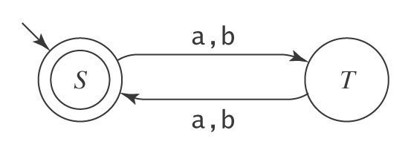
Regular Grammar Example
L = {w ∈ {a, b}* : |w| is even} ((aa) ∪ (ab) ∪ (ba) ∪ (bb))*
M:
G: S → ε
S → aT
S → bT
T → aS
T → bS
Notice the clear correspondence between M and G
  Given one, easy to derive the other
Notes:
By convention, the start symbol of any grammar G will be the symbol on the left-hand side of the first rule
The job of the nonterminal S is to generate even length strings.
The job of the nonterminal T is to generate odd length strings.

Slide 37
Regular Languages and Regular Grammars
Theorem: The class of languages that can be defined with regular grammars is exactly the regular languages.
Proof: By two constructions.

Slide 38
Regular Languages and Regular Grammars
Regular grammar → FSM:
grammartofsm(G = (V, Σ, R, S)) =
1. Create in M a separate state for each nonterminal in V.
2. Start state is the state corresponding to S .
3. If there are any rules in R of the form X → w, for some
w ∈ Σ, create a new state labeled #.
4. For each rule of the form X → w Y, add a transition from
X to Y labeled w.
5. For each rule of the form X → w, add a transition from X
to # labeled w.
6. For each rule of the form X → ε, mark state X as
accepting.
7. Mark state # as accepting.
FSM → Regular grammar: Similarly.

Slide 39
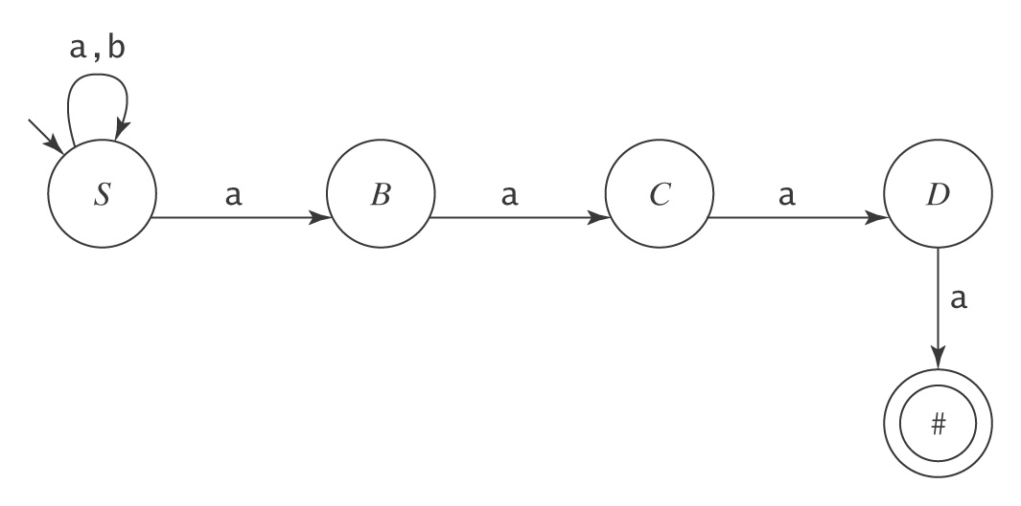
Strings That End with aaaa
L = {w ∈ {a, b}* : w ends with the pattern aaaa}.
S → aS
S → bS
S → aB
B → aC
C → aD
D → a

Slide 40
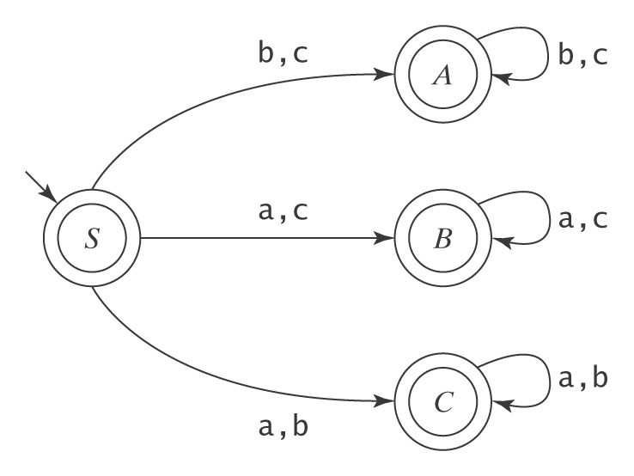
One Character Missing
L = {w ∈ {a, b, c}*: there is a symbol in the alphabet not appearing in w}.
S → ε A → bA C → aC
S → aB A → cA C → bC
S → aC A → ε C → ε
S → bA B → aB
S → bC B → cB
S → cA B → ε
S → cB

